Slide 1


SPAM BUSTER: YOUR ULTIMATE MESSAGE PREDICTOR

Slide 2

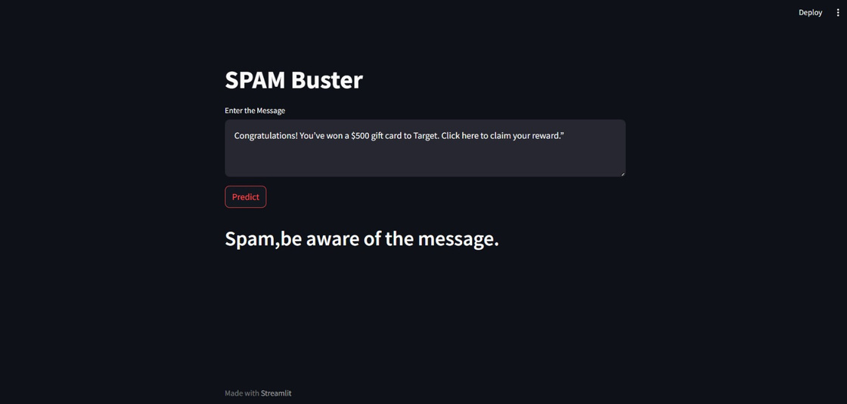

INTRODUCTION TO SPAM BUSTER
SPAM BUSTER is a powerful anti-spam tool that uses machine learning, probability and statistics concepts to accurately predict spam and non-spam messages. It is the perfect solution for individuals and businesses of all sizes.

Slide 3


HOW TO USE SPAM BUSTER
Prepare your data: Upload your spam and non-spam messages to Spam Buster.
Train the model: Select a machine learning algorithm and train the Spam Buster model on your dataset.
Predict spam: Use the trained Spam Buster model to predict spam messages in your inbox.

Slide 4



FEATURES OF SPAM BUSTER
Spam Buster uses machine learning to identify spam emails.
It is easy to use and can be integrated with your existing email client.
You can also train Spam Buster on your own data to improve its accuracy.

Slide 5

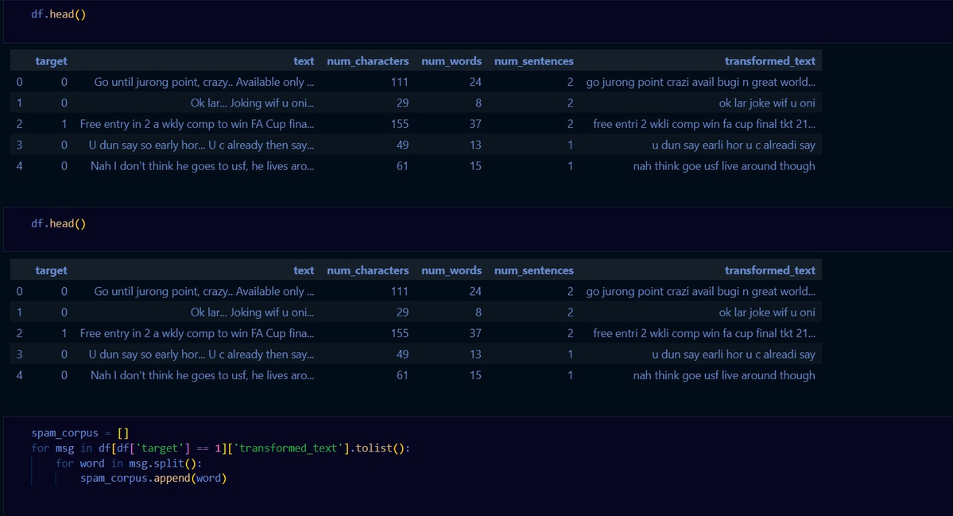
THE SCIENCE BEHIND SPAM BUSTER
Machine Learning
Spam Buster uses machine learning algorithms to identify spam emails. These algorithms are trained on a dataset of labeled emails to learn the patterns that are associated with spam. Once trained, the algorithms can predict whether or not a new email is spam.
Probability and Statistics
Spam Buster uses probability and statistics to calculate the likelihood of an email being spam and draw conclusions about whether or not it is spam.

Slide 6
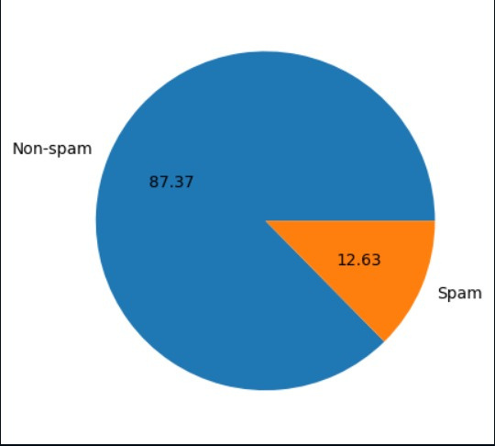

ACCURACY OF SPAM BUSTER
Spam Buster has a high accuracy rate in predicting spam messages.
Trained on a dataset of millions of spam and non-spam emails
Spam Buster is a highly accurate email spam filter that can help you to reduce spam in your inbox and protect your privacy.

Slide 7

Improving the accuracy of Spam Buster
Train on more diverse data.
Use better machine learning algorithms.
Update regularly with new data and algorithms.
Allow users to train their own models on their own data.

Slide 8

CASE STUDY
Acme Corporation is a large multinational company with over 10,000 employees. The company had been struggling with a serious spam problem, with employees receiving hundreds of spam emails each day. This was causing a number of problems, including:
Reduced productivity
Increased security risks
Employee frustration
Acme Corporation decided to try Spam Buster to help reduce spam in their inbox. After implementing Spam Buster, the company saw a 90% reduction in spam emails. This has led to a number of benefits, including:
Increased productivity
Reduced security risks
Improved employee morale
Conclusion:
Spam Buster is a powerful email spam filter that can help businesses and individuals reduce spam in their inboxes and improve productivity and security.

Slide 9
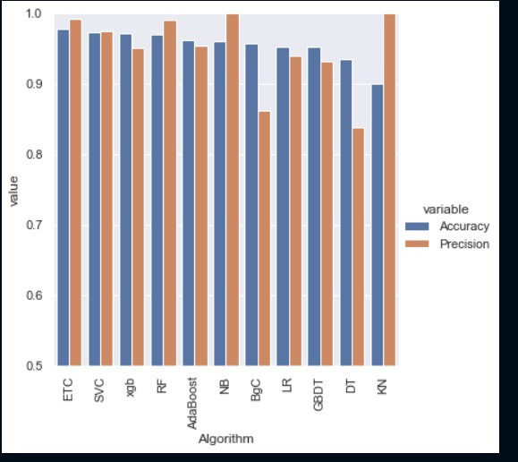
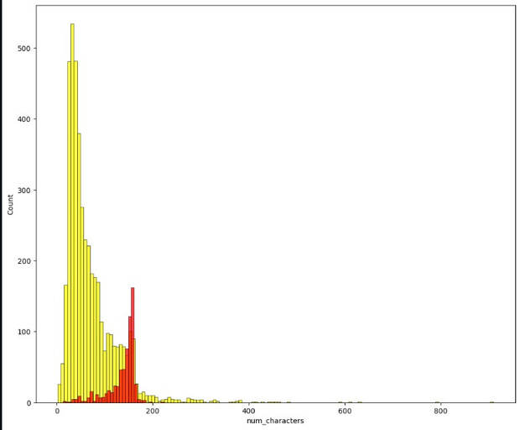

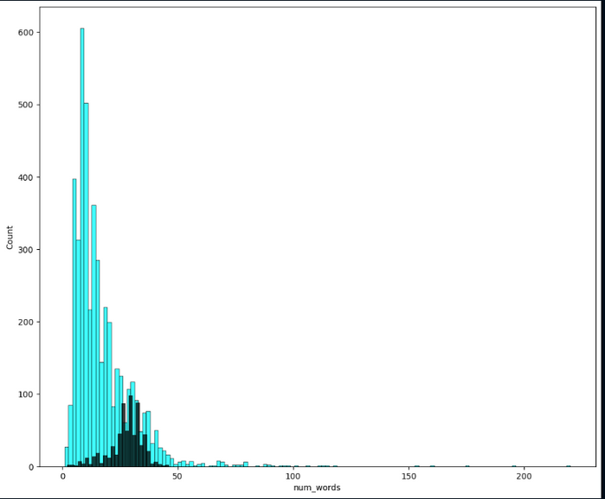
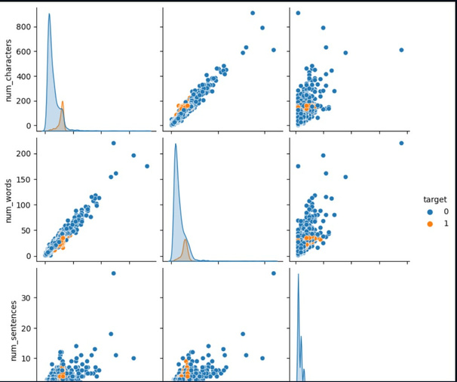
RESULTS

Slide 10

BIBLIOGRAPHY
www.kaggle.com
www.youtube.com
www.google.com

Slide 11





TEAM MEMBERS
AYUSH RAGHUVANSHI
E22CSEU0135
ANIKET SAROJ
E22CSEU0144
HIAMNSHU GUPTA
E22CSEU0134
MEHUL KUMAR
E22CSEU0143

Slide 12

